Slide 1
Leveraging Standards-Based MOSA for SWaP-Constrained Deployable Systems with VNX+
Mark Littlefield
Elma Electronic

Slide 2
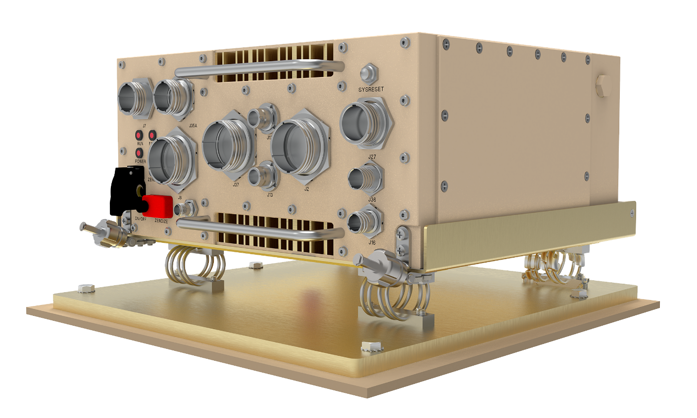
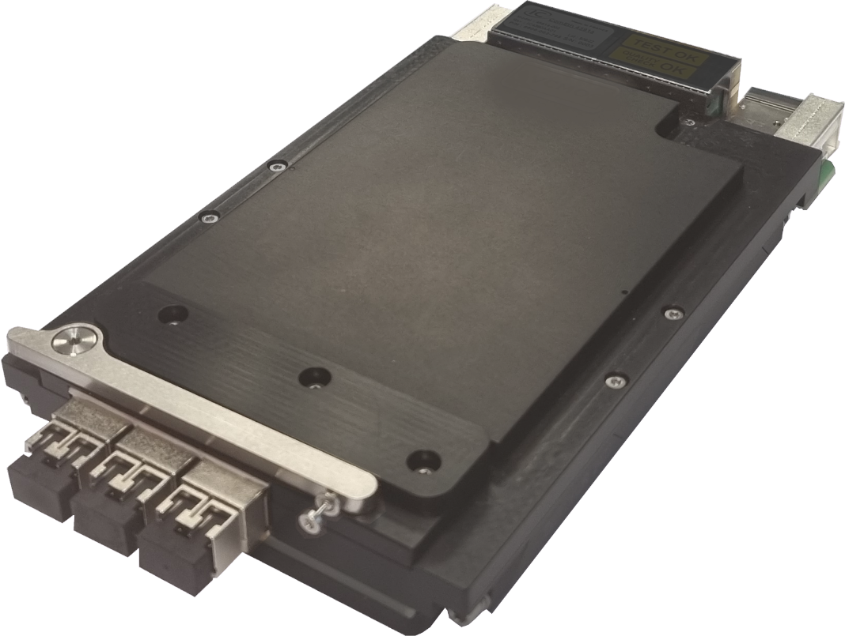
What are the Benefits of MOSA Standards
According to the Defense Standardization Program MOSA page:
  Significant cost saving or avoidance
  Schedule reduction and rapidly deploy new technology
  Opportunities for technical upgrades and refresh
  Interoperability, including system of systems interoperability and mission integration
  Other benefits during the sustainment phase of a major system
SOSA Aligned OpenVPX has been repeatedly shown to be an ideal form factor for leveraging MOSA in ground vehicle applications
But what do you do if your application SWaP requirements are too constrained for 3U OpenVPX?
  Enter VNX+

Slide 3
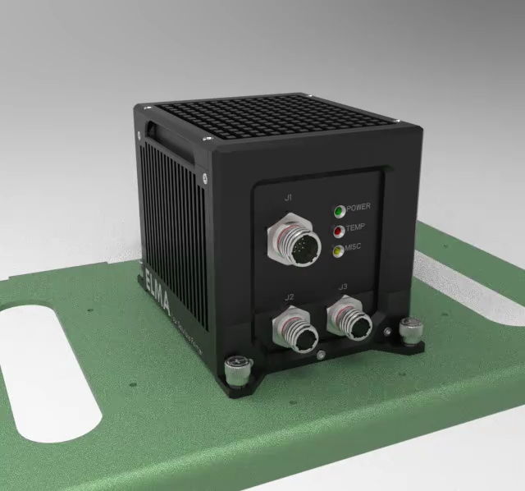
VNX+: SOSA Small Form Factor
VNX+ was specifically designed for small, rugged, sensor processing systems
In 2020 SOSA formed the Small Form Factor Subcommittee to find or create a form factor “significantly smaller than 3U VPX” for inclusion into the Technical Standard
  After an exhaustive trade study, SFFSC decided VNX could meet SOSAs needs – but with some significant enhancements
These enhancements were significant enough that VITA decided to create a new standard: VITA 90 / VNX+
VNX+ preserves all the basic features of SOSA OpenVPX
But in a package less than 1/3 the size
In this presentation we will examine
The significant features of VNX+
What SOSA leverages from the various VITA 90 documents
How VNX+ can play a role in crewed and uncrewed ground vehicles

Slide 4

VITA 90: VNX+
VNX+ is captured by a series of documents:
VITA 90.0: VNX+ Base Standard
VITA 90.1: VNX+ Profile Tables
VITA 90.2 (VDSTU): VNX+ Optical and Coax Apertures
VITA 90.3: VNX+ Power Supply and Storage Modules
VITA 90.4: VNX+ Cooling and Mounting Systems
VITA 90.5: Space VNX+ (in work)
VITA 90.7: VNX+ Optical and NanoRF Coax Apertures Standard
SOSA® builds on this basic material

Slide 5
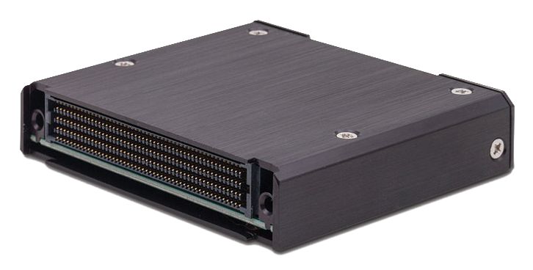
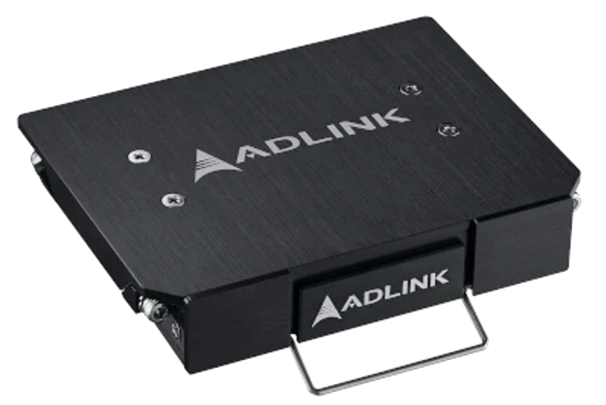
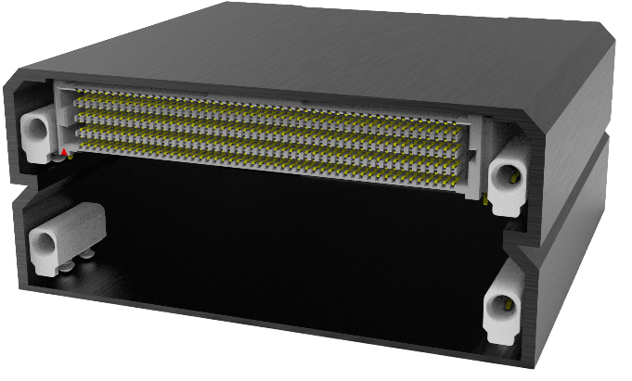
VNX+ Fundamentals
VNX+ is a module standard – it defines the shape and the connector-side interfaces
  What goes on inside is 100% up to the designer
  Chassis design and cooling mechanisms are 100% up to the designer
19mm and 13mm modules defined by VITA
  SOSA only adopted 19mm nodules
Double-height modules are permitted
  SOSA only allows the Type-B shown here
Metal enclosure forms the external cooling interface
VITA 90.0 defines the basic design with no wedgelocks
  Offers superior cooling due to large edge surface contact areas
  Messy – requires thermal interface material
VITA 90.4 defines a design that includes wedgelocks
  Much easier to integrate and maintain (no TIM)
  Small thermal contact area along the wedgelock platform can cause challenges for higher power systems
19mm modules have three different connectors
  To provide options with an aperture for blind-mate optical or coaxial connectors
19mm
89mm
78mm
101.6mm
78mm
19mm

Slide 6
S0 Utility Segment
GigE MDI
(add magnetics)
Dual IPMB
Maintenance Port
Power Planes
VPX Common Signals
USB
UEIO
GPIO
Serial

Slide 7
UEIO
Unique External I/O: Special Port for System-Specific I/O
The UEIO Pins are 8 Pins in UEIO Segment of the Utility Segment will support the following allowable combinations of SPI and I2C interfaces:
1x to 4x I2C
1x to 2x SPI
2x I2C and 1x SPI
1x I2C and 1x SPI with 1x-2x SPI Selects
1x SPI with 1x-5x SPI Selects
2x SPI with 1x SPI Select each
Intention is to “talk” to front-panel devices and sensors

Slide 8
UEIO
Unique External I/O: Special Port for System-Specific I/O
The UEIO Pins are 8 Pins in UEIO Segment of the Utility Segment will support the following allowable combinations of SPI and I2C interfaces:
1x to 4x I2C
1x to 2x SPI
2x I2C and 1x SPI
1x I2C and 1x SPI with 1x-2x SPI Selects
1x SPI with 1x-5x SPI Selects
2x SPI with 1x SPI Select each
Intention is to “talk” to front-panel devices and sensors
SOSA Configuration

Slide 9
S2 Communications Segment and S3 Overlay Segment
2x FP Expansion Planes
8x Expansion Plane Lanes
2x FP Expansion Planes
2x FP Data Planes
2x FP Expansion Planes
2x FP Expansion Planes
Copper and Aperture Overlay Region
2x UTP Control Planes

Slide 10

VNX+ and SOSA
VNX+ actually originated within the SOSA Small Form Factor working group
The basic templates, along with the initial slot profiles were defined
The utility segment was crafted to mirror (and extend beyond) OpenVPX
The requirements for Optical/Coaxial connector modules, as well as power were established
All of this material was passed to VITA for inclusion into the VITA 90 standard

Slide 11
Approved SOSA Slot Profiles
400 Pin Payload: VNX.PL-1-HH.400-8.2.1.1-<General Payload>
320 Pin Payload: VNX.PL-1-HH.320-8.2.2.1-<General Payload>
400 Pin Switch: VNX.SW-1-HH.400-8.4.1.1-<7DP/8CP Switch>
  7x Data Plane, 8x Control Plane
320 Pin Switch: VNX.SW-1-HH.320-8.4.2.1-<5DP/5CP Switch>
  5x Data Plane, 5x Control Plane
  Dual MT Optical
7-Slot Radial Clock: VNX.RC-1-HH.320-8.5.2.2-<7REFCLK/7AUXCLK Overlay>
  Based on the Payload Template
  7x REF_CLK/AUX_CLK pairs
High-density 320 pin Radial Clock: VNX.RC-1-HH.320-8.5.2.1-<22REFCLK/22AUXCLK>
  Not based on the template
  22x REF_CLK/AUX_CLK pairs
Power Supply Units (PSU - Balanced) and Power Conditioning Cards (GND/GND/Open +16-36VDC)

Slide 12
Protocols: AMPS
VITA 65 defines AMPS: the Alternate Module Profile Scheme
  VITA 90 did something similar
SOSA VNX+ will follow the same protocols as VPX (Ethernet, PCIe, etc.)
Approved protocols are:
  Data Plane
    1000BASE-KX
    10GBASE-KX4
    10GBASE-KX
    40GBASE-KX4
    25GBASE-KX
    100GBASE-KX4
  Expansion Plane
    PCIe Gen2/3/4
    Serial FPDP 10/25
    LVDS
  Control Plane
    1000BASE-KX
    10GBASE-KR
  Peripheral Port
    SATA Gen 1/2/3

Slide 13
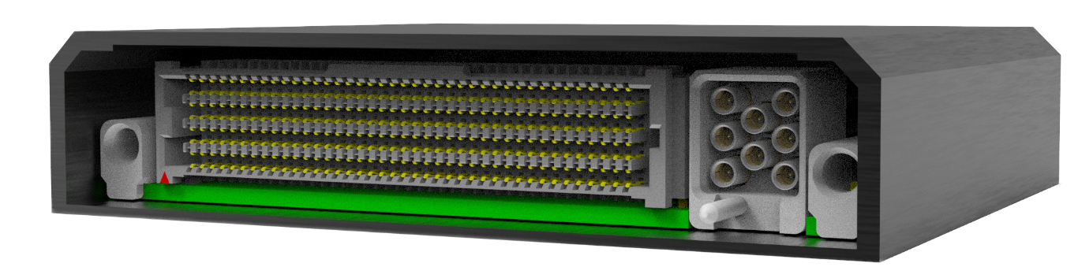
VITA 90.2 Connector Modules
Like OpenVPX, VNX+ has connector modules for blind-mate optical and coaxial connections
Optical Only
Hybrid Optical and Coax
Coax Only
Support for both 50Ω and 75Ω contacts

Slide 14
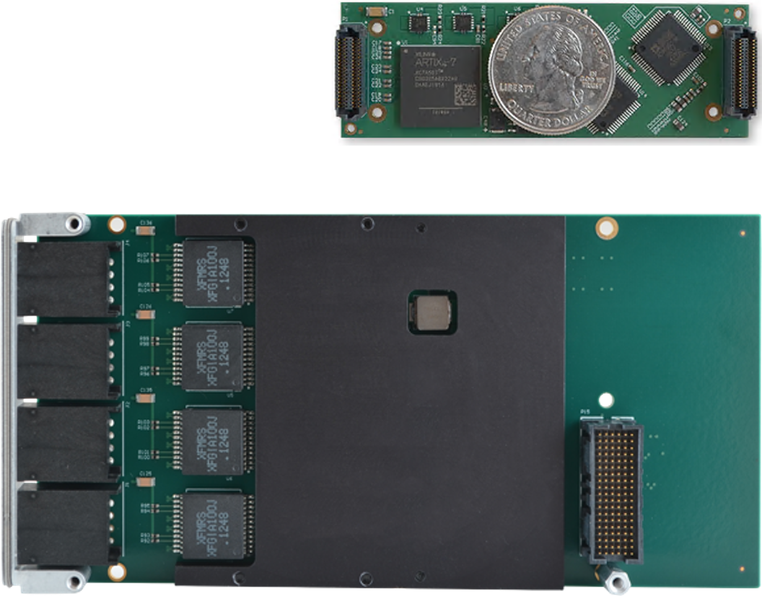
What is Mezzanine Mapped I/O?
And why is it important?
VITA 90.1 slot profiles have a fixed, limited set of I/O ports
  VITA 90.1 includes no provision for “user-defined I/O”
Thus, a mechanism to allow I/O capabilities to be added to base modules is needed
  Particularly important for external I/O
  Video and other streaming data, platform busses like CANBus, specialized camera interfaces, etc.
OpenVPX achieves this by using XMC cards
  XMC is too large to fit inside a VNX+ module
VITA 93.0 (QMC) was written to create a new, small form factor mezzanine I/O card small enough to fit inside VNX+
  High-performance (up to PCIe Gen5) host and backplane I/O connectors
  Sized to fit up to two modules (or one double-wide) in a VNX+ module
  Definition for conduction cooling

Slide 15
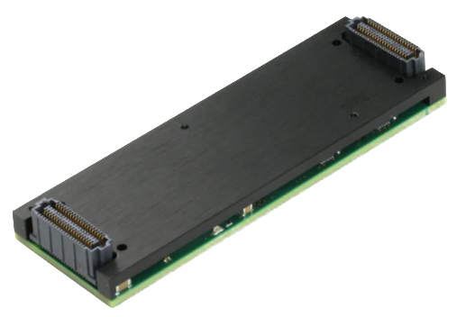
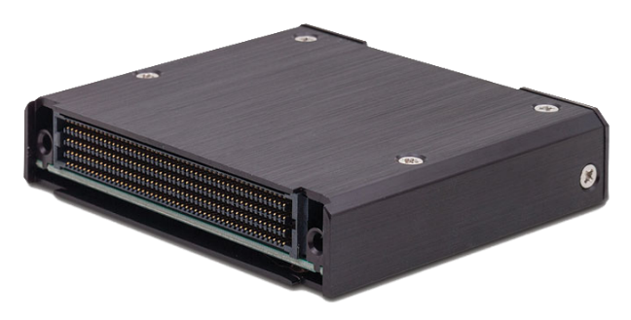
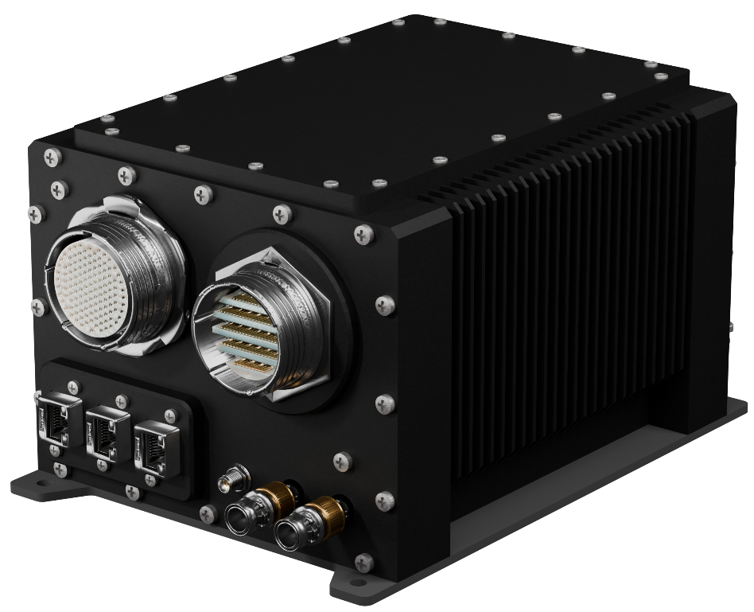
Example: Basecard Technology Insertion
Remove the QMC from the VNX+ Module
Insert the QMC into the new VNX+ Module
Remove the old VNX+ Module
Insert the new VNX+ Module

Slide 16
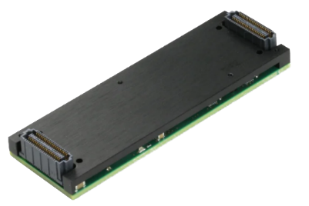

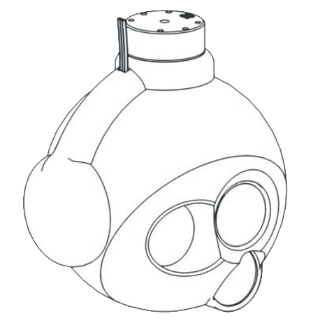
Example: Sensor Upgrade
Remove the original QMC sensor interface from the VNX+ Module
Insert the new QMC sensor interface into the VNX+ Module
Remove the VNX+ Module
Insert the VNX+ Module
Remove Old Sensor
Attach New Sensor

Slide 17

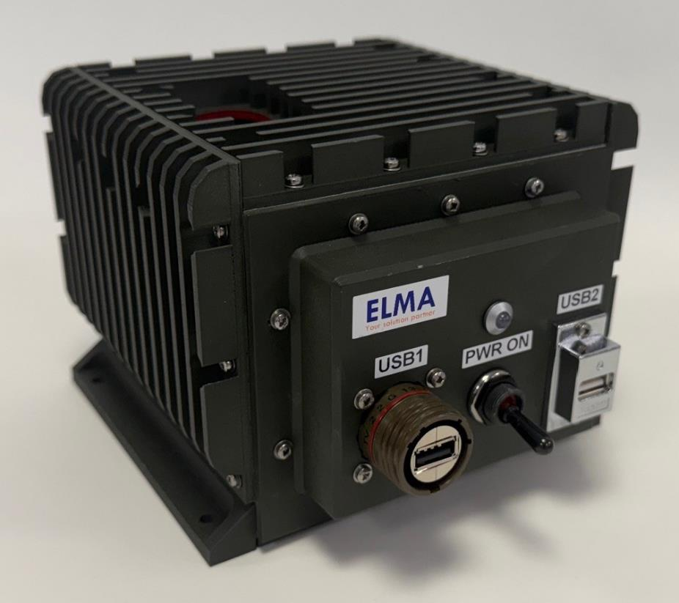
VNX+ for Crewed and Uncrewed Ground Vehicles
3U OpenVPX (especially SOSA aligned) is a very attractive form factor for ground vehicle systems
  High-performance, relatively compact, rugged
  Sometimes, even 3U is too large for some applications
  VNX+ is designed specifically for that problem
  Here are some of the features that make VNX+ ideally suited for ground vehicle applications – whether crewed or uncrewed
  Small form factor – less than 1/3 the size of 3U OpenVPX on a per-slot basis
  Same Utility Segment features as 3U OpenVPX (and then some – like UEIO)
  Same Data Plane/Control Plane/Expansion plane architecture
  25/100 GigE and PCIe Gen5
  VITA 46.11 Tier 3 System Management
  Built in 1000BASE-T for connectivity to vehicle busses

Slide 18

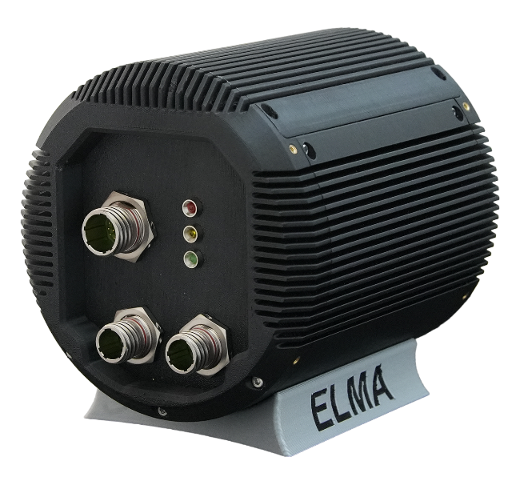
Value of VNX+
The VNX+ architecture brings a lot of value to the system integrator for SWaP-Constrained Systems
High-bandwidth interconnect
  Critical for high-end payloads
I2C/SPI interfaces through UEIO
  Important for device control and low-level sensors and effectors
  Not found on OpenVPX
Fiber optic and coax links
Mezzanine-mapped I/O
  Easy integration of custom/special I/O
Out-of-band system management
Lastly: Brings MOSA to small form factor systems
  Faster integration, faster technology refresh

Slide 19
Thank You For Your Time

